Slide 1
SuperMatching: Feature Matching using Supersymmetric Geometric Constraints
Submission ID: 0208

Slide 2
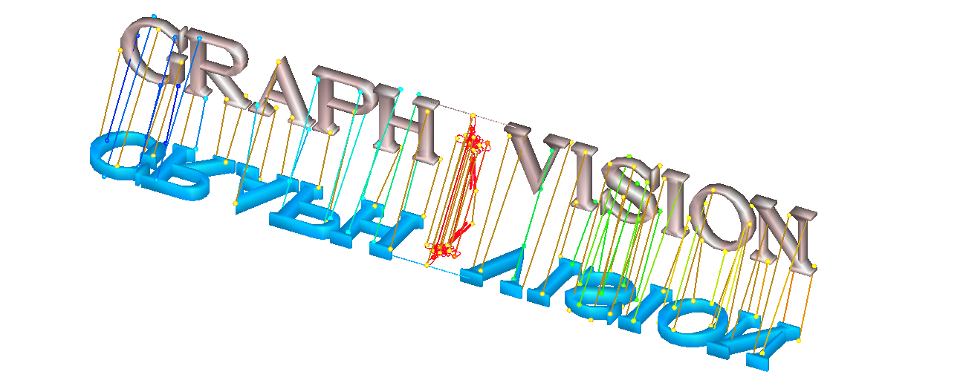
Overview
SuperMatching is:
A fundamental matching algorithm in GRAPHics and VISION tasks
Pairwise matching using uniformly sampled points on the 3D shapes

Slide 3
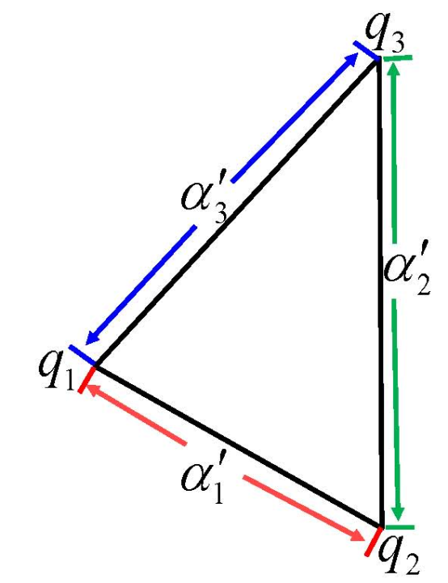
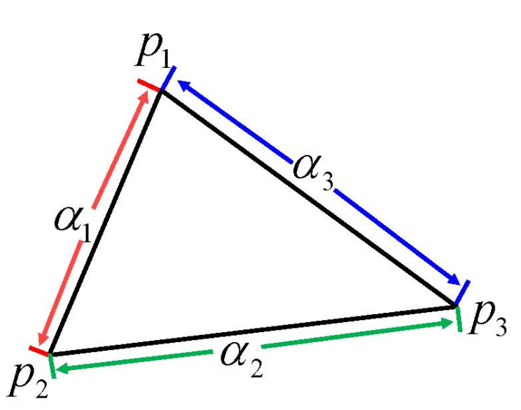
Overview
SuperMatching is:
Using feature tuples (triangles or higher-order tuples)
Formulated as a supersymmetric higher-order affinity tensor
Third-order diagram (edge length invariance in 3D triangles)

Slide 4
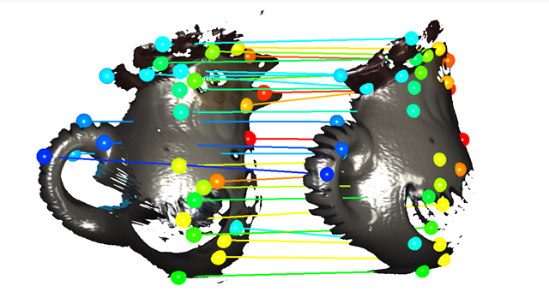
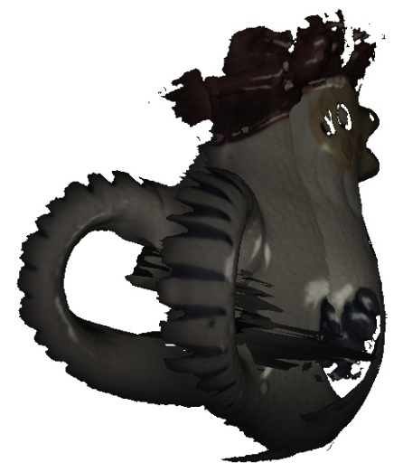
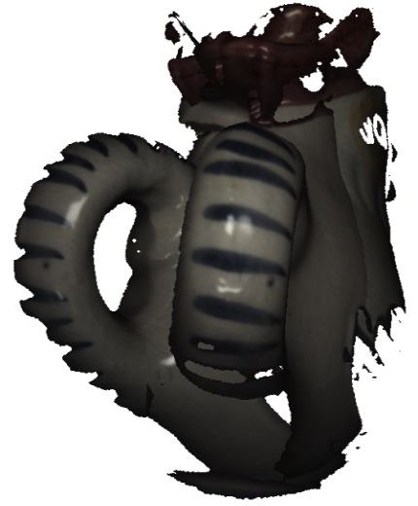
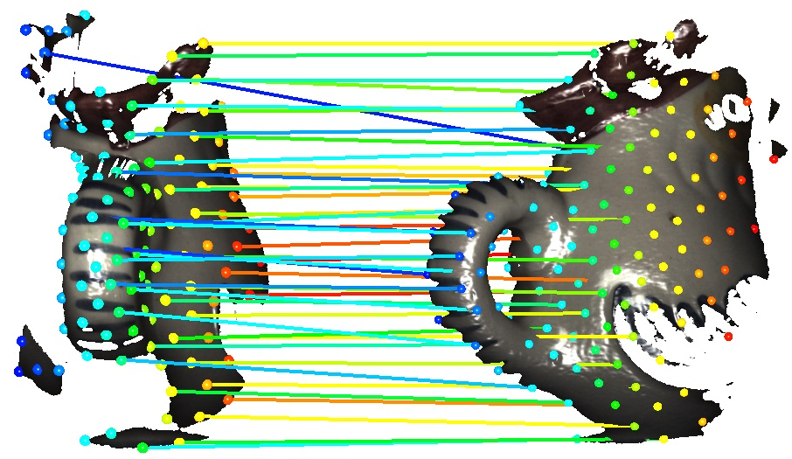
3D rigid shapes scans
Pairwise matching of Rooster scans
I
II
II
III
Initial poses Matching result

Slide 5
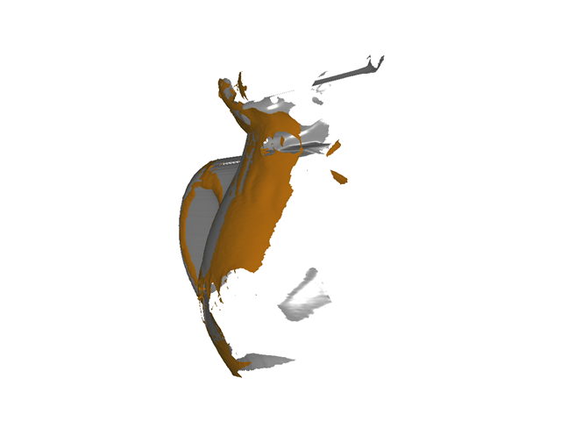
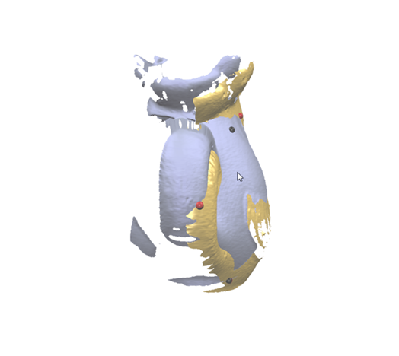
3D rigid shapes scans
Comparison with 4PCS [Aiger et al. 2008]
SuperMatching
[Aiger et al. 2008]
Rooster II-III pairwise registration

Slide 6
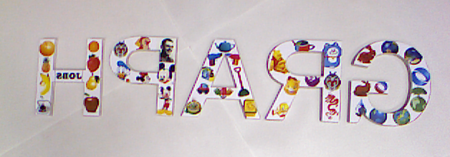
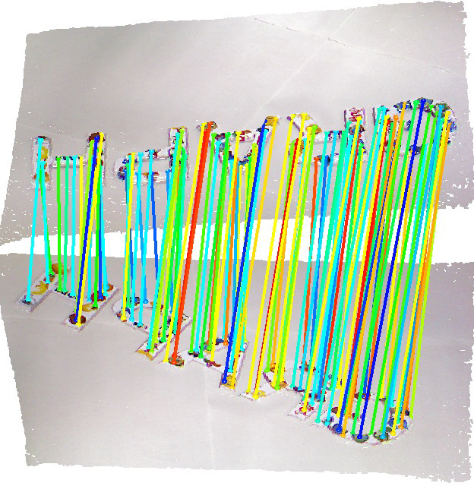
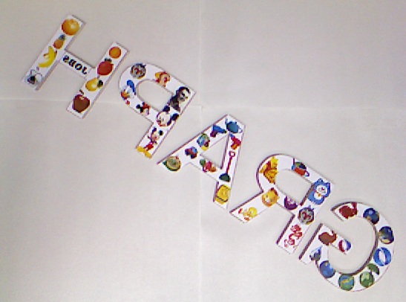

3D real depth scans
Colored Scene captured by Kinect
Source shape
Target shape
Final alignment
Pairwise Matching

Slide 7
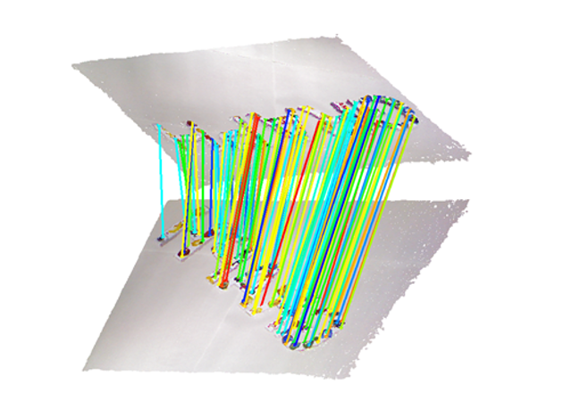
3D real depth scans
Colored Scene captured by Kinect

Slide 8
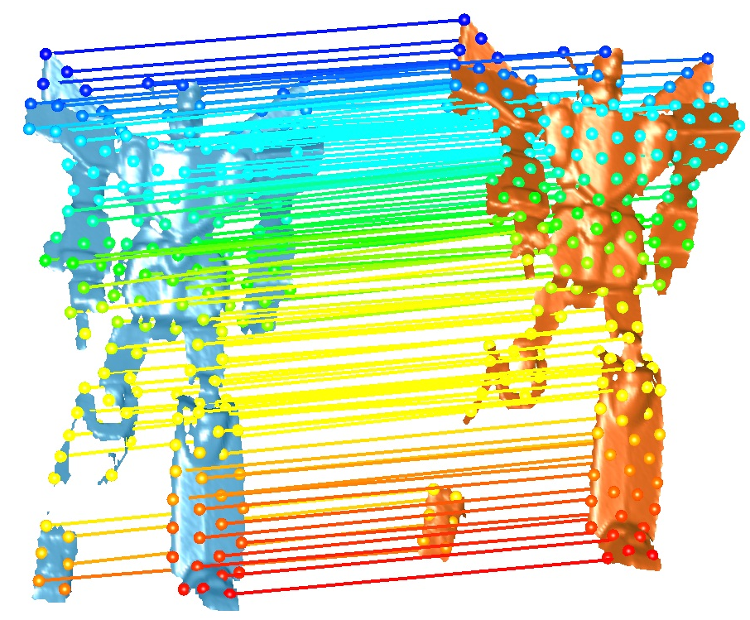
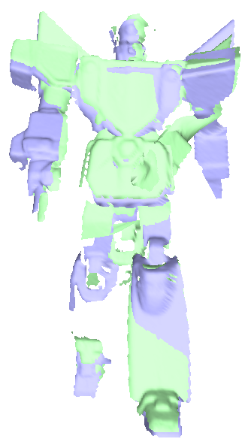
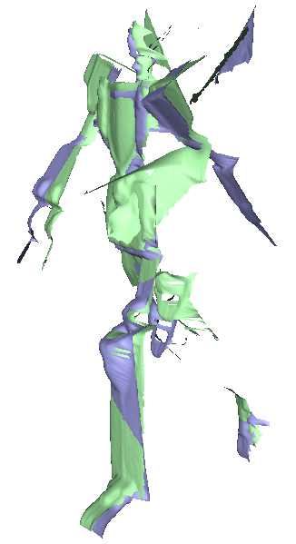
3D articulated shapes
Articulated Robot between frame 9 and 10
distortion
SuperMatching
[Chang and Zwicker 2009]

Slide 9
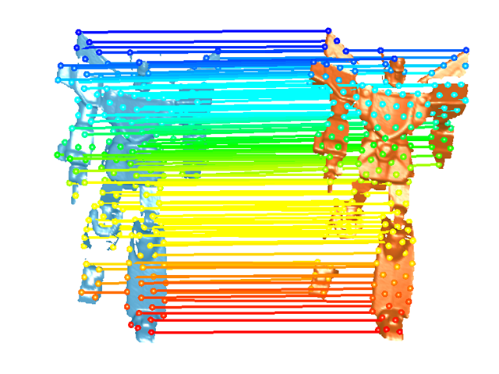
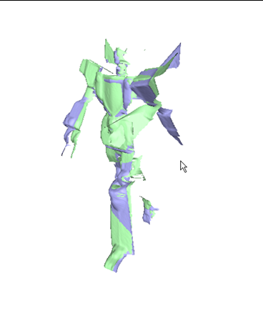
3D articulated shapes
Articulated Robot between frame 9 and 10
SuperMatching
[Chang and Zwicker 2009]

Slide 10
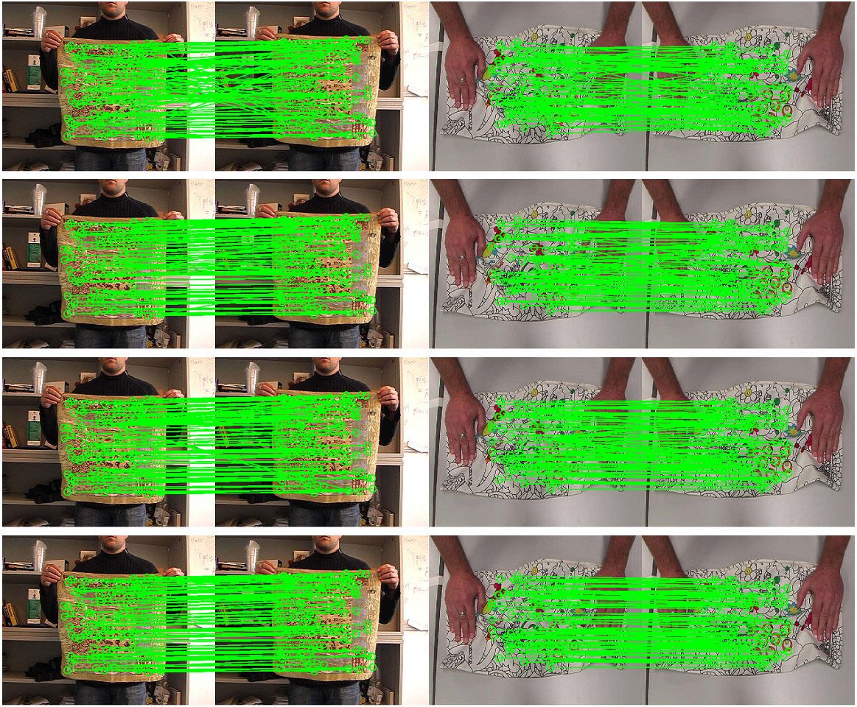
Deformable surfaces
Spectral method
[Cour et al. 2006]
Hyper graph matching
[Zass and Shashua 2008]
A third-order tensor
[Duchenne et al. 2009]
SuperMatching
cloth: F80-F90
cushion: F144-F156

Slide 11
Deformable surfaces
Accuracy and Time-costs
Dataset | cloth |  |  |  | cushion
Pairwise Matching | F80- F90 | F90- F95 | F95- F100 | F100- F105 | F144- F156 | F156- F165 | F165- F172 | F172- F188 | Times (Sec)
Super-Matching | 83% | 85% | 84% | 81% | 66% | 60% | 69% | 56% | 8
[Zass and Shahua 2008] | 73% | 79% | 70% | 72% | 44% | 39% | 54% | 43% | 6.5
[Duchenne et al. 2009] | 67% | 77% | 73% | 65% | 39% | 31% | 47% | 42% | 13
[Cour et al. 2006] | 27% | 29% | 22% | 27% | 14% | 5% | 28% | 7% | 5

Slide 12
Deformable surfaces
Accuracy and Time-costs
Dataset | cloth |  |  |  | cushion
Pairwise Matching | F80- F90 | F90- F95 | F95- F100 | F100- F105 | F144- F156 | F156- F165 | F165- F172 | F172- F188 | Times (Sec)
Super-Matching | 83% | 85% | 84% | 81% | 66% | 60% | 69% | 56% | 8
[Zass and Shahua 2008] | 73% | 79% | 70% | 72% | 44% | 39% | 54% | 43% | 6.5
[Duchenne et al. 2009] | 67% | 77% | 73% | 65% | 39% | 31% | 47% | 42% | 13
[Cour et al. 2006] | 27% | 29% | 22% | 27% | 14% | 5% | 28% | 7% | 5
More accurate with competitive time

Slide 13
Deformable surfaces
Accuracy and Time-costs
Dataset | cloth |  |  |  | cushion
Pairwise Matching | F80- F90 | F90- F95 | F95- F100 | F100- F105 | F144- F156 | F156- F165 | F165- F172 | F172- F188 | Times (Sec)
Super-Matching | 83% | 85% | 84% | 81% | 66% | 60% | 69% | 56% | 8
[Zass and Shahua 2008] | 73% | 79% | 70% | 72% | 44% | 39% | 54% | 43% | 6.5
[Duchenne et al. 2009] | 67% | 77% | 73% | 65% | 39% | 31% | 47% | 42% | 13
[Cour et al. 2006] | 27% | 29% | 22% | 27% | 14% | 5% | 28% | 7% | 5
More accurate with competitive time

Slide 14


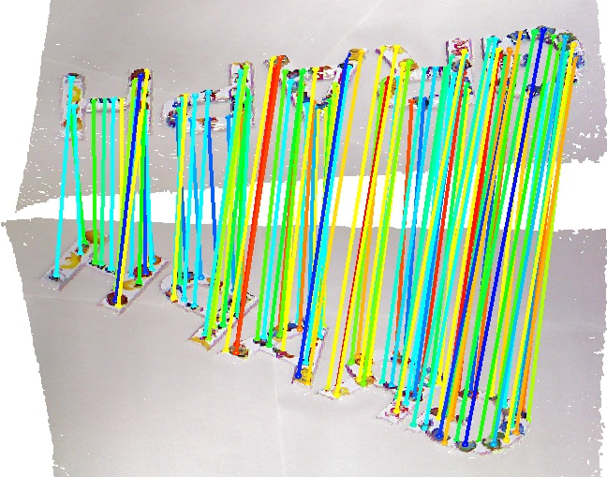
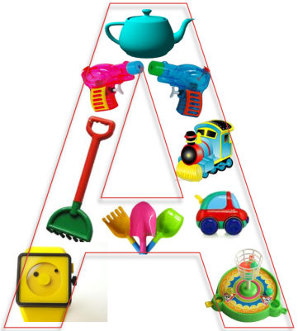
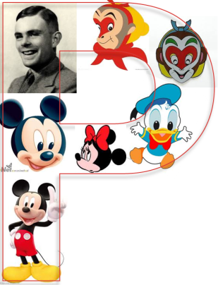

Thanks
Real 3D data captured by Kinect

